Slide 1
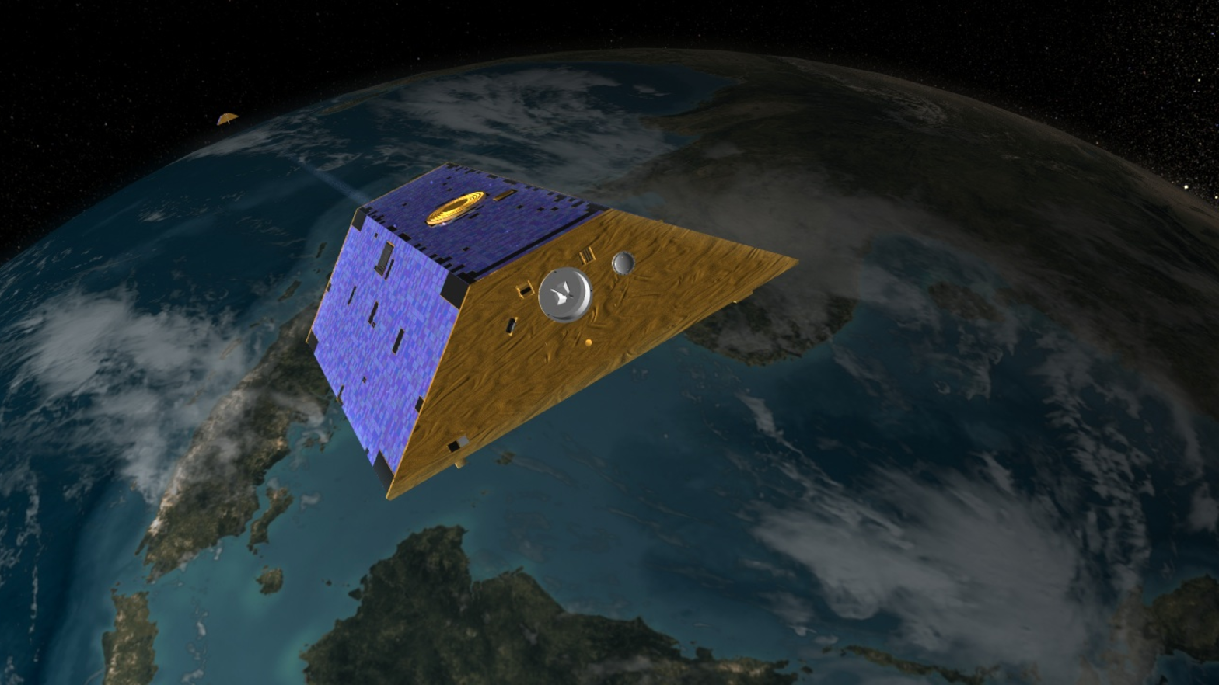
GRACE satellites capture our changing relationship with groundwater
Significance:
Communities are relying on groundwater more as temperatures become hotter and drier, especially in irrigated agricultural areas.
GRACE satellites can directly observe these changes and help communities plan for drought conditions and conserve groundwater resources.
Background:
Due to their depth and overlying geologic conditions, deep water aquifers have historically taken many years for their water levels to reflect overall climatic conditions.
Due to recent changes in Earth’s temperature and precipitation patterns, communities have begun pumping deep water aquifers at faster rates, causing them to more directly reflect climatic changes.
Analysis:
Two studies—one focusing on northwestern India and the other on aquifers across the United States—used GRACE data and NASA climate models to determine changes in groundwater storage over time and how they related to variations in climate.
Artist rendition of the Gravity Recovery and Climate Experiment (GRACE) satellites.

Slide 2
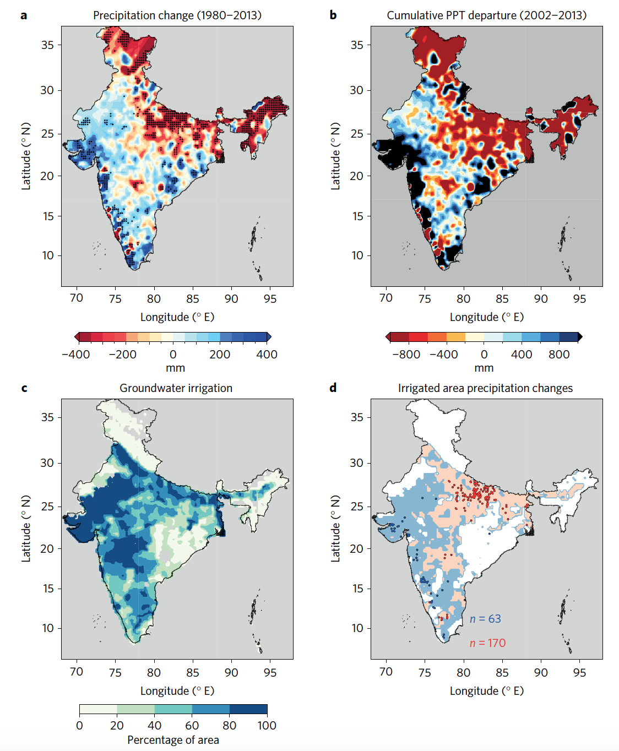
GRACE satellites capture our changing relationship with groundwater
Changes in Earth’s climate have direct and indirect consequences on groundwater availability in India
Long-term changes in monsoon precipitation are driving changes groundwater storage directly through recharge and indirectly through climate-induced agricultural pumping.
Increased SST during ENSO events weakens the Indian monsoon, leading to increased agricultural pumping and lower groundwater levels.
The amount of water pumped depends on choice of crops, subsidized electricity, and market driven prices
Source: Asoka, A. et al. Relative contribution of monsoon precipitation and pumping to changes in groundwater storage in India. Nat. Geosc. Vol 10, 109-117 (2017).
Changing precipitation patterns compared to areas with high groundwater irrigation rates across India.
Notes:
More on analysis/methods: GRACE data is available from 2002 onwards. To get a larger dataset, the study estimated changes in the groundwater depth using a linear trend in groundwater table depth from well observations from 1996-2013. They used the non-parametric Mann-Kendall trend test and Sens slope method. Results showed a significant decline (approx 15-25cm per year) in groundwater depth during this time.

Slide 3
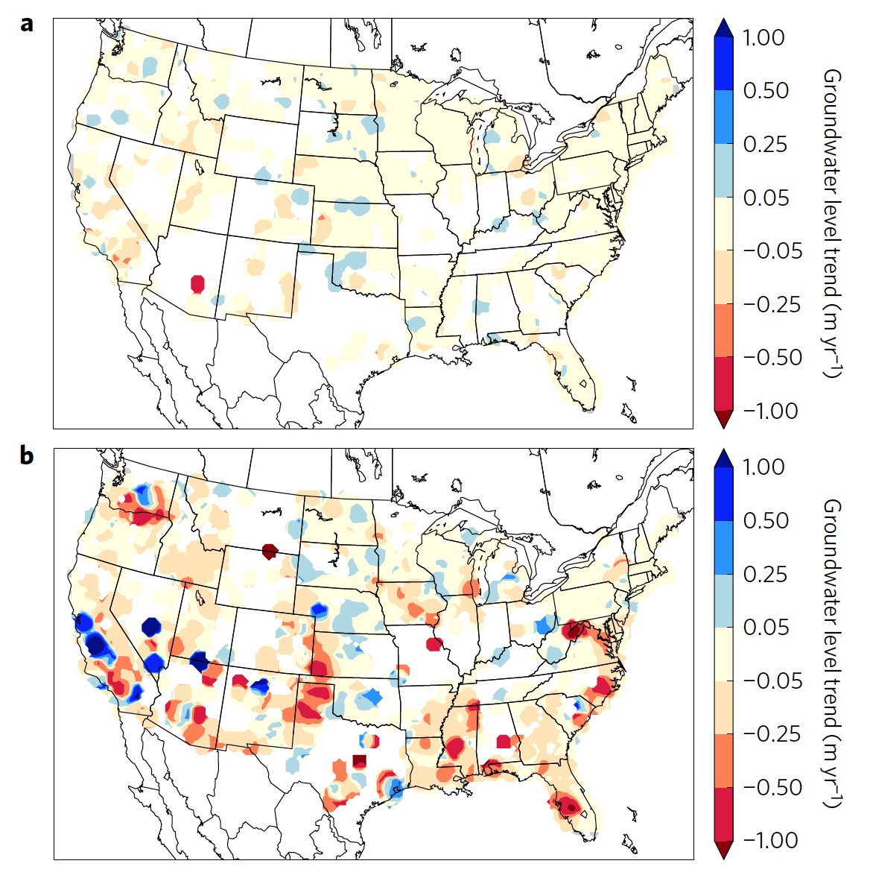
GRACE satellites capture our changing relationship with groundwater
Groundwater levels in deep aquifers across the United States correspond to climate variations
Water levels in deep groundwater aquifers (>30m) across the United States reflect climate variations over timescales less than one year, including the High Plains Aquifer and Mississippi Embayment.
Climate indices, including ENSO, NAO and PDO, showed that overall coherence increased with depth, with the deepest aquifers (>150m) correlating most closely with the ENSO and NAO indices.
This result was unexpected, since deep aquifers are typically semi-confined and their depth and geologic makeup make them less susceptible to short-term changes in precipitation and more susceptible to inter-annual or longer timescales.
Source: Russo, T. A. & Lall, U. Depletion and response of deep groundwater to climate-induced pumping variability. Nat. Geosc. Vol 10, 105-108 (2017).
Average groundwater level rate of change for shallow (a) and deep (b) wells.
Notes:
More on analysis/methods: The study examined a subset of 1,515 wells (652 shallow; 665 medium; 198 deep) with nearly continuous groundwater level observations from 1963 and 2004.
Groundwater level records were clustered and then compared to each climate index. Of the three climate indices analyzed, the shallow and medium groundwater records showed the greatest coherence to ENSO and PDO. The deepest well depth category showed a stronger coherence with ENSO and NAO, rather than to PDO. Overall coherence with the ENSO, PDO and NAO increased with depth, suggesting strong groundwater climate connections in the deep aquifers.
They studied the response of groundwater levels to local precipitation variability using a vector autoregression (VAR) impulse response function estimate applied to annual time series of the two variables. The model coefficients suggest that the groundwater response is largest within the first year of the precipitation change for all well depth categories. The time required for a recharge signal to travel from the land surface to the groundwater depends on aquifer properties and moisture content; for water tables more than a few meters from the surface or confined aquifers, it can take several years to respond to precipitation and groundwater recharge variability. However, local groundwater responses to changes in water pumping are observable immediately.

